Slide 1

wDesk Training Guide

Slide 2

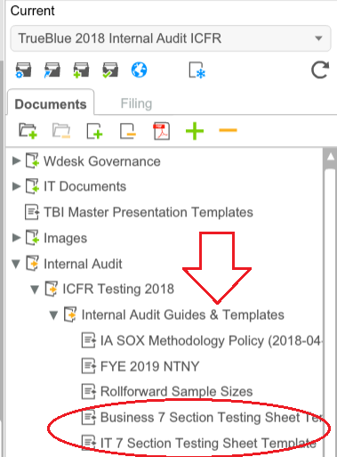
wDesk 2018 Getting Started – Templates & Guides
Templates
When starting a testing phase for a control, review workpaper to ensure that the current template is reflected
Link to wDesk Business Templates
You can find templates here:

Slide 3
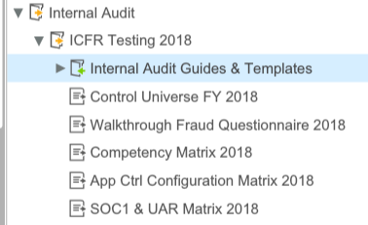
wDesk Getting Started
Internal Audit Materials – Guides
Make sure to look at the Notes to Next Year (“NTNY”) when you are starting to ensure that you don’t miss out on process improvements.
Sample Sizes, Status Definitions Guides, and Memo templates can also be found here.
Internal Audit Materials – Matrices and Other Materials
Please look in wDesk for materials first (for easy access and updating). If you need something in wDesk that you can’t find, please contact the IA wDesk administrator (Megan or Jo-Anne). These materials support testing workpapers.

Slide 4
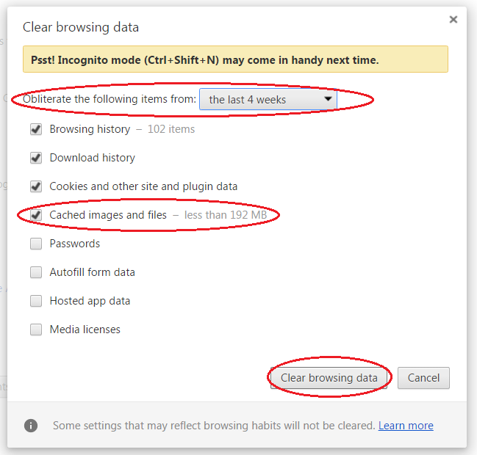
wDesk Basics
Speed
The bowser that offers the fastest wDesk speed is Chrome
Clear your browser cache weekly to improve speed
Click the menu to the top right of the browser and select “More tools”, select “Clear Browser Data”, ensure the time period is sufficient (default is 1 hour – so set for one week) and “Cached images & files” box is checked before pressing the “Clear browsing data” button

Slide 5
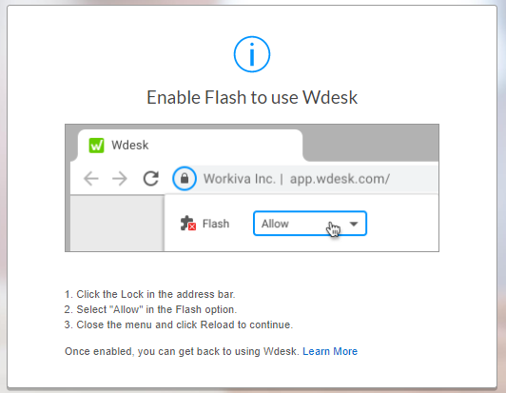
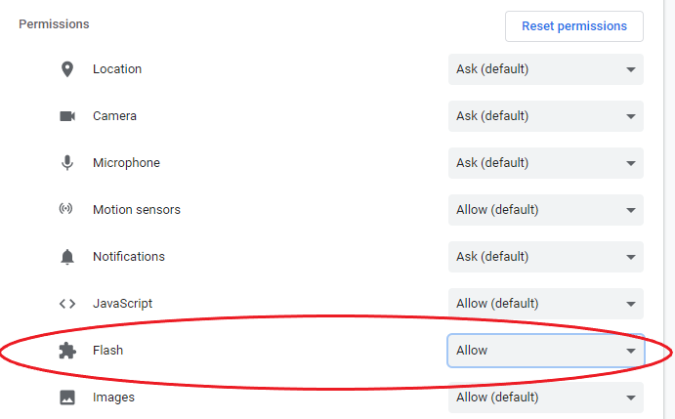
wDesk Basics
Flash
wDesk uses Flash, which you will need to enable in Chrome after selecting a project from the home screen
When selecting a project, wDesk will prompt you to enable Flash
If this is your first time enabling flash after clearing your browser cache, you will need to select “Site settings” from the above pictured drop-down to enable Flash

Slide 6
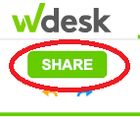
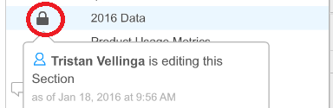

wDesk Basics – Basic Functionality
Share = Save
Share is located top left below the wDesk icon
If you are working on a document, no one else can work on that document until you share – if you are in a document that everyone needs to work on (i.e. control universe), share as soon as you are done updating – Sharing is Caring
If a document is being edited by someone else, a lock icon will appear to the left of the document in the Document Outline pane on the left hand side of the window; Scrolling over this symbol will show the name of the person who is in the document
If you have unsaved edits to a workpaper a pencil icon will appear next to the work paper in the Document Outline pane
Share speeds – wDesk operates in the cloud – the more you do between shares and the more links there are the longer it will take
If there is high traffic through the wDesk, sharing slows down and may take a significant amount of time
Pro-tip: Ask colleagues to share if you are locked out for a significant amount of time

Slide 7
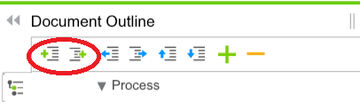
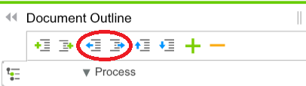
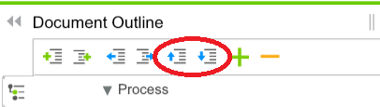
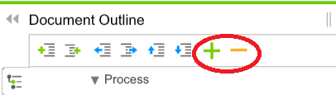
wDesk Basics – Basic Functionality
Document Outline Navigation
“Add Before” / “Add After” buttons – adds a new blank worksheet before/after the worksheet you have selected in the outline
“Promote” / “Demote” buttons – moves workpapers in and out of drop down buckets – promote takes it up a level and out of a bucket; demote takes it down a level and into a bucket
“Move Up” and “Move Down” buttons – moves a workpaper or a bucket of workpapers up and down in the outline
“Collapse All” / “Expand All buttons” – closes or opens all dropdowns in the document outline.

Slide 8
wDesk Basics – Basic Functionality - Tabs
File Tab
Open – lets you open other projects
Save & Save As – these export either PDFs or excel sheet wDesk documents to your computer (it doesn’t save your work in wDesk)
Validate (from drop down select section) – if you see errors in blue popping up in the bottom left of your screen, you can use validate to find these (typically they relate to cells not being right sized, but can also relate to rounding on calculations)
Discard – gets rid of changes you made to the document (great for if you accidentally made a change and undo button isn’t fixing it)

Slide 9
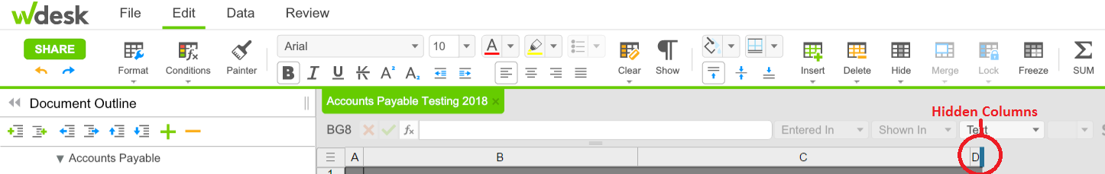
wDesk Basics – Basic Functionality - Tabs
Edit Tab
Formatting - just like excel
Hidden columns and rows – you can hide/unhide columns by right clicking or using the drop down at the top – hidden columns and rows show up as a thick blue line on the axis

Slide 10
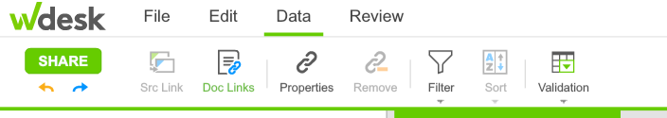
wDesk Basics – Basic Functionality - Tabs
Data Tab
Can filter columns from here
Data validation lives here – check with a wDesk admin before changing things here

Slide 11
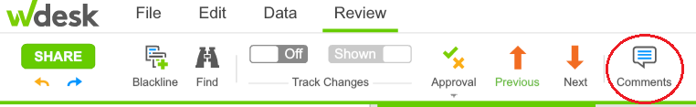
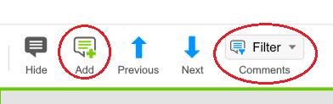
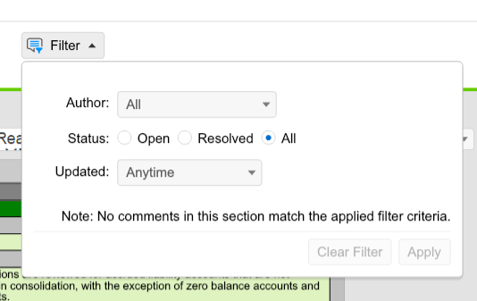
wDesk Basics – Basic Functionality - Tabs
Review Tab
Comments – click the “Comments” button to see comments in document (this will open the comment pane)
Leaving comments – select cell and
click “Add” button
Filtering Comments – click “Filter” drop-down; you can filter by the name of creator, status, and when the comment was made

Slide 12
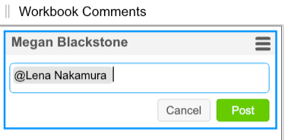

wDesk Basics – Basic Functionality - Tabs
Review Tab pt. 2
Send comments/questions directly to reviewers –Type @NameofReviewer in your comment and they will receive an email notification of the comment
At a glance – does this workpaper have a comment? If a workpaper has a comment, a speech bubble will appear to its left in the Document Outline pane on the left hand side of the window.

Slide 13
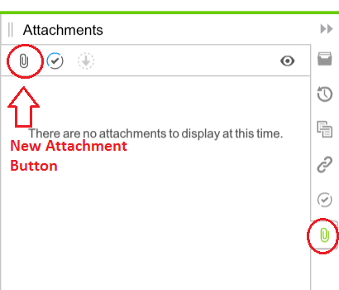
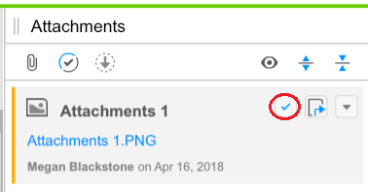
Using wDesk
Attachments
Add attachments using the Attachment tab on the right hand side by clicking the new attachment button.
Attached files will display exactly as if the document was printed. Before attaching documents in wDesk, use the “print preview” functions of the source applications (i.e. Excel, Adobe, Word) to verify that file margins and orientation is set up to enable complete viewing and readability in wDesk.
If you need to change the cell an attachment is tied to, select the attachment and uncheck the check mark, select the cell you want to reattach to and check the box to attach to the new cell.

Slide 14
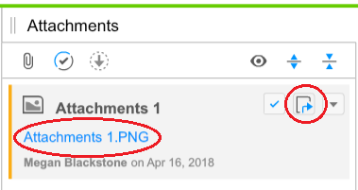
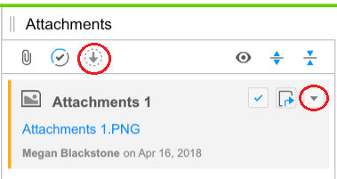
Using wDesk
Attachments pt. 2
To view attachments in wDesk, click on either the blue attachment link or the up right arrow button.
To download/delete/replace/remove files, select the file and use the drop down menu (see image below on right side).
To download all attachments, click the down arrow at the top of the attachment pane.

Slide 15
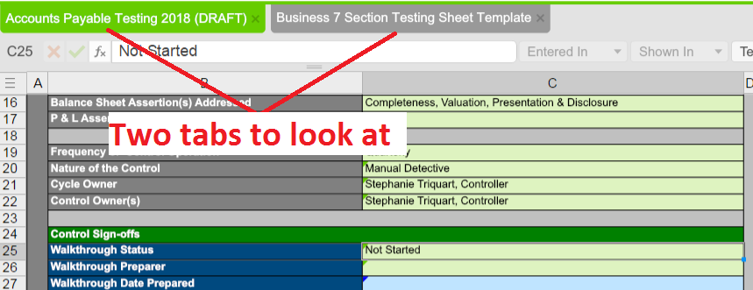
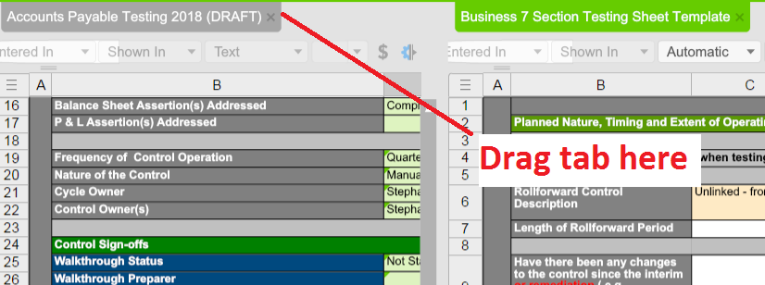

Using wDesk
Split Screen
If you would like to look at two tabs at the same time (i.e. PY and CY testing papers) you can split the screen
Click on the tab you want on the right and drag it into the edit pane on the right (you will see a green “+” when you are in the right place)
Data Validation
Small triangles in the right of the cell indicate data validation – Please do not remove or hard key here.

Slide 16
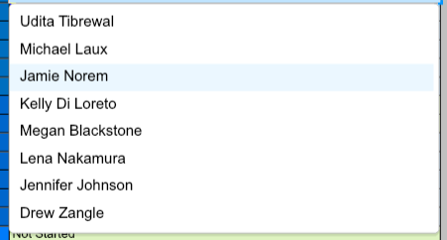
Using wDesk
Data Validation pt. 2
Use drop down menu to populate field.
If you don’t find what you are looking for (i.e. Your name on the Summary tab), contact a wDesk admin (Megan or Jo-Anne) to add to the drop down.

Slide 17

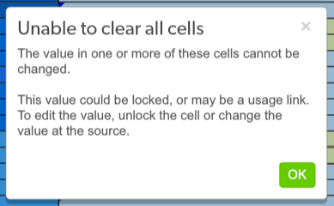
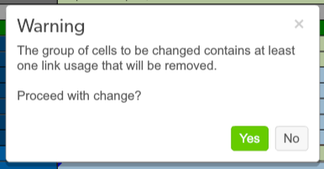
Using wDesk
Links
Links allow for changes in one place in the document to automatically flow through to other parts of the document
Links can be identified by the small blue or green triangles in the top left corner of cells:
Please do not break links – it is time consuming to repair them. You will know you may be trying to break a link if you see either of these error message:

Slide 18
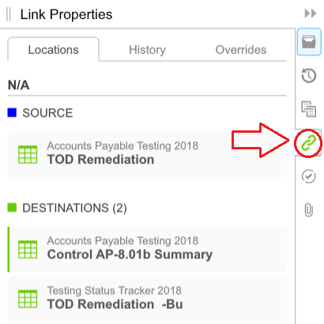
Using wDesk
Links pt. 2
Instead of clicking on remove link or over-writing the link, find the source link and update there.
You can find the source link by using the linking tab on the right pane. It will have a blue flag in the top left of the cell.
Review your link paths to ensure they are flowing to the correct place.

Slide 19

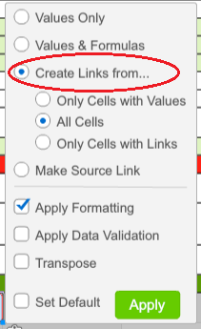
Using wDesk
Links pt. 3
Creating New Links
To create a new link, copy the source link cell and paste into the cell you would like linked. You will see a clip board icon on the bottom right of the cell you paste to.
Right clicking this will give you an option list for how to paste – click “Create link from…” to create a new link. You can use this process to link to multiple places from the same source:
You can also move the source link using this
menu by clicking on “Make Source Link” or by
right clicking on the cell and clicking “Make
Source Link”.

Slide 20
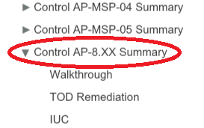
Using wDesk – New Controls
Linked Workpapers
If you have a new control, there is a chance that there is already a linked template you can use.
Go to they cycle the new control fits in and look for a control labeled “Control Proc-##.XX Summary” – the XX indicates a linked template that is not currently being used.
Find the linked Control in the Control Universe and update control there.
No Linked Workpapers
Use the add documents buttons in the document outline pane (see wDesk Basics – Basic Functionality) and use the templates to populate the fields (see wDesk Getting Started – Templates and Guides)
Delete blank cells to the right and below the template cells
Link to control universe and add data validation

Slide 21
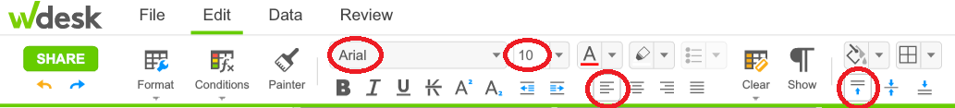
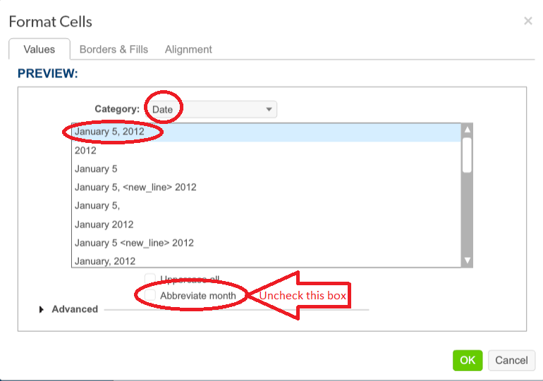
wDesk Formatting
General Formatting
Ariel - 10
Top Left
Correct spelling errors underlined in red (hint: if a word is spelled correctly you can right click to add to dictionary)
Titles – Bold
Fields – Not Bold
Date Formatting
Right Click – Format Cells
“Date” - Month DD, YYYY
Uncheck Abbreviate month
Pro tip: select whole table (see next slide) when formatting

Slide 22
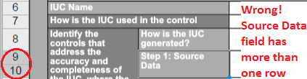
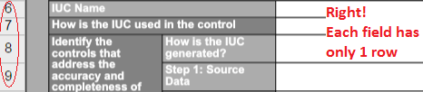
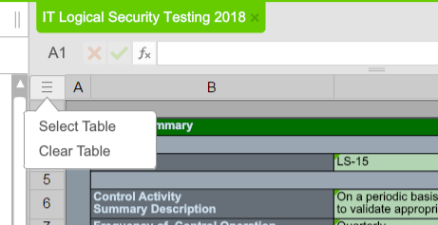
wDesk Formatting
Right Sizing Fields (once testing is complete)
Make sure fields are only one cell high
Select Table
Double click between rows
All text will be visible
If this is not done, upon archiving, the document will not be readable.

Slide 23
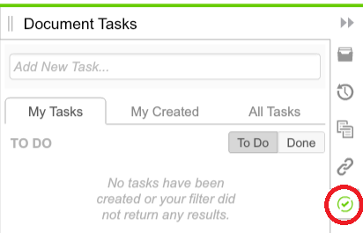
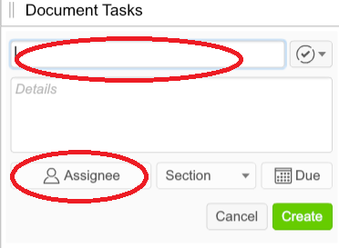
Using wDesk
Submitting Workpapers - Tasking
When you complete a workpaper – task it to the reviewer using the task tab on the right hand pane
Add new task using the naming conventions from the Nomenclature on the next slide.
Include any details that may need more attention from the reviewer in the details section if applicable.
Use the Assignee button to assign to reviewer listed in the control universe.

Slide 24
Using wDesk
Submitting Workpapers – Tasking pt. 2
Nomenclature
I. Phase – Control # – Status (examples below)
II. Walkthrough – AP 3 – Effective
III. Interim – AP 3 – Ineffective
IV. RF – AP 3 – Ineffective
V. TOE/TOD Remediation – AP 3 – Effective
VI. Lookback – AP 3 – Effective
VII. IUC – AP 3 – Effective

Slide 25
Learning More About wDesk

Slide 26
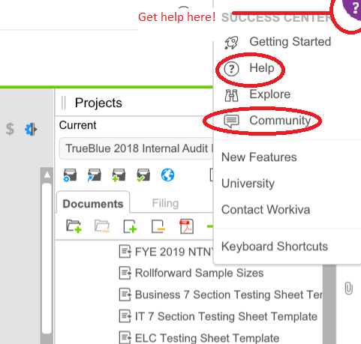
Where can I learn about wDesk functionality?
wDesk has two great resources!
wDesk help center
wDesk community

Slide 27
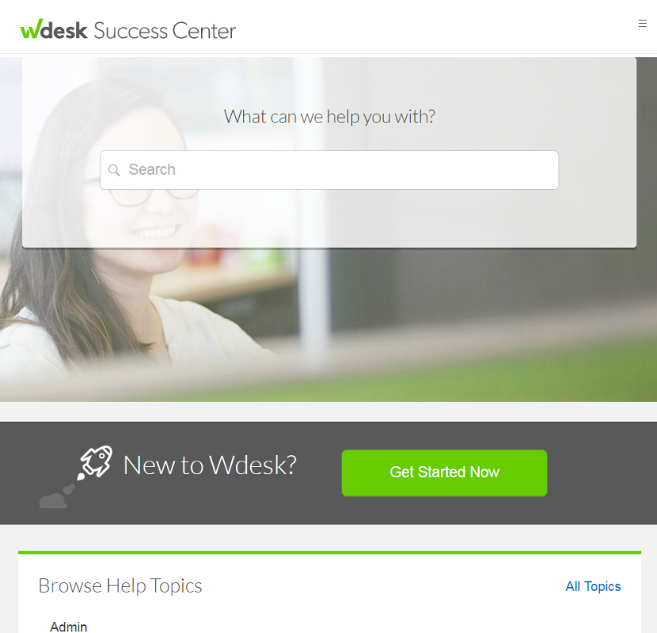
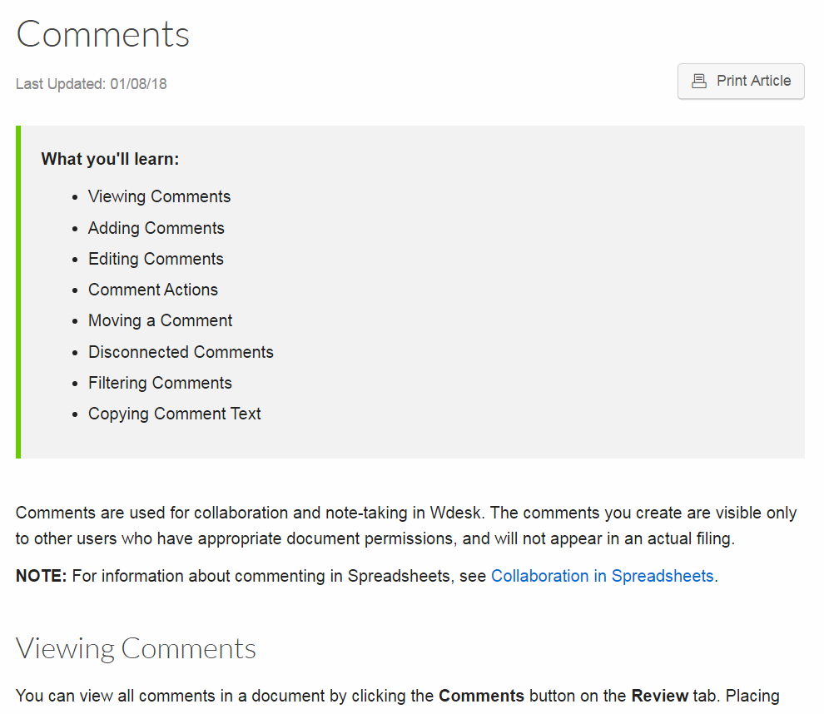
wDesk Help Center
Search by topic!
Articles and Video Modules for Training on wDesk Tools and Functionality

Slide 28
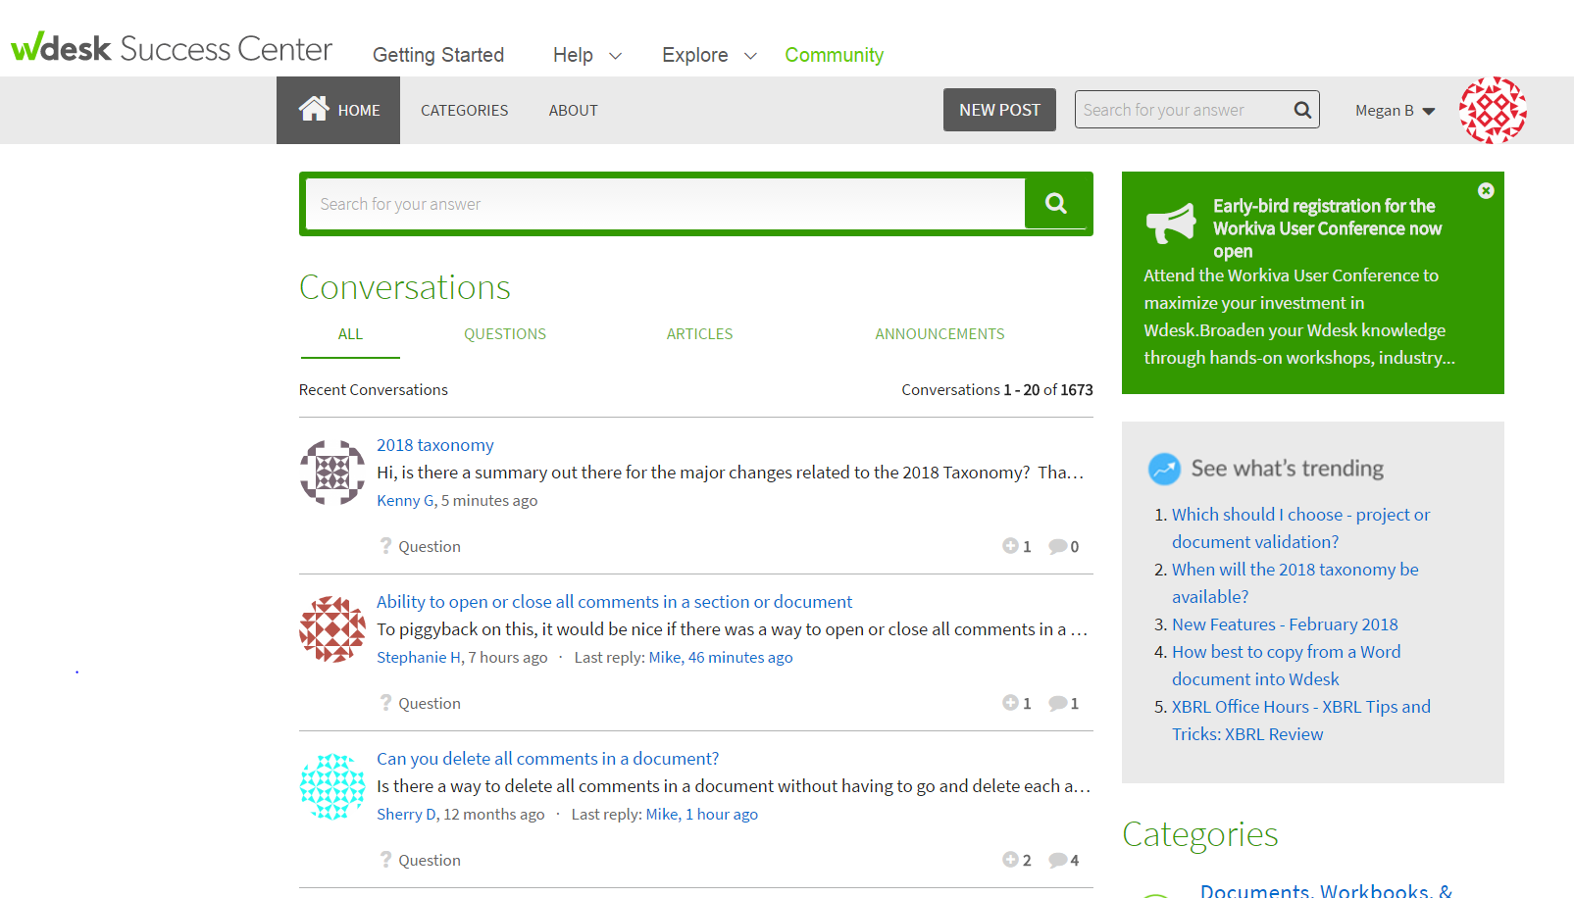
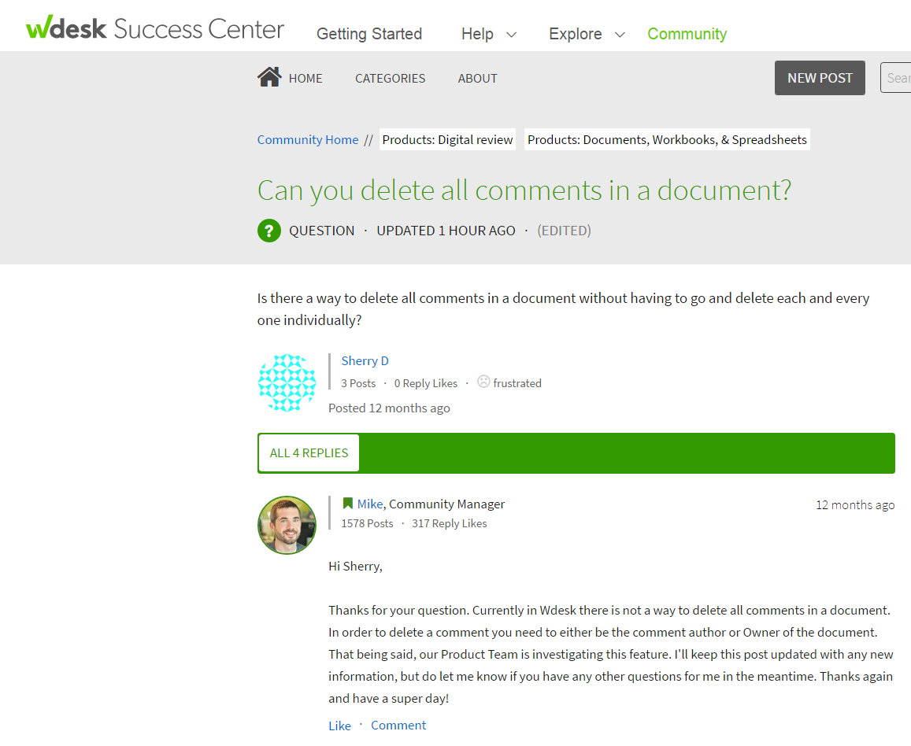
wDesk Community
Ask Other wDesk Users for Tips and Tricks
Use your wDesk log-in your first time using this site
Search by topic
Moderated by wDesk staff (who often answer questions)
Other users add their input

Slide 29
wDesk Quick Reference Guide
See our Internal Audit Guide for quick tips and tricks
Q:\Loss Prevention\Department Admin\Employee Management\Onboarding\Onboarding Templates and Supports\IA Guides\Wdesk guides

Slide 30

Thank you! Questions?

